Slide 1
“Island Confinement” (1990) Sakiyama Tami
島籠る
崎山多美

Slide 2
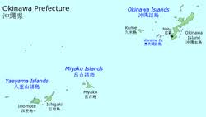
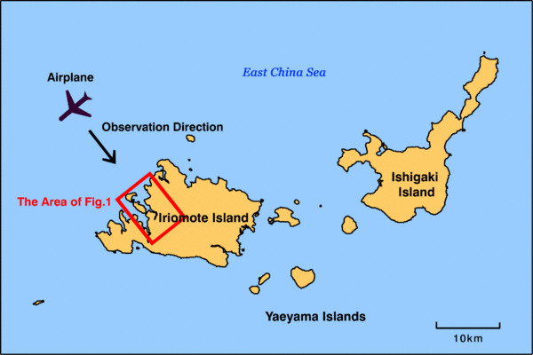
Maps

Slide 3
Keywords
Island stories, language
dance
T/O; Kohama Island
depopulation
Guilt, betrayal, tradition, modernization, identity
Writing

Slide 4
Discussion Questions
Compare and contrast Sakiyama’s and Medoruma’s fiction.
Compare and contrast Toki and Takako.
What do you think Takako will do finally?
What would you do?

